Slide 1

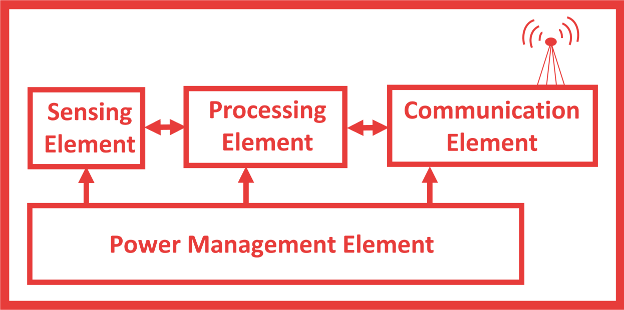
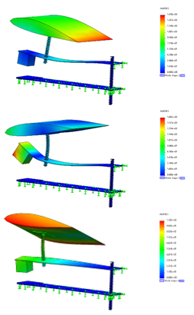
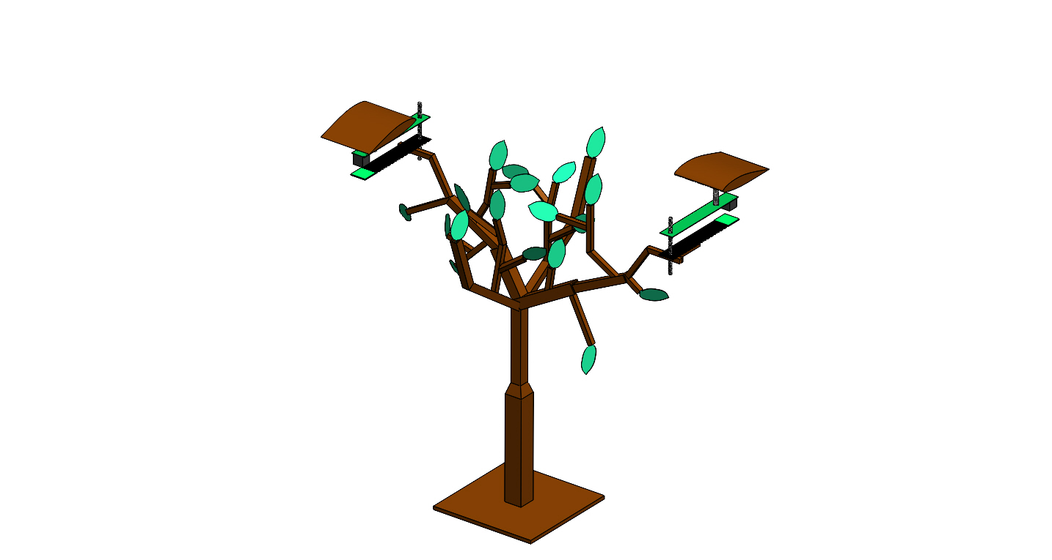
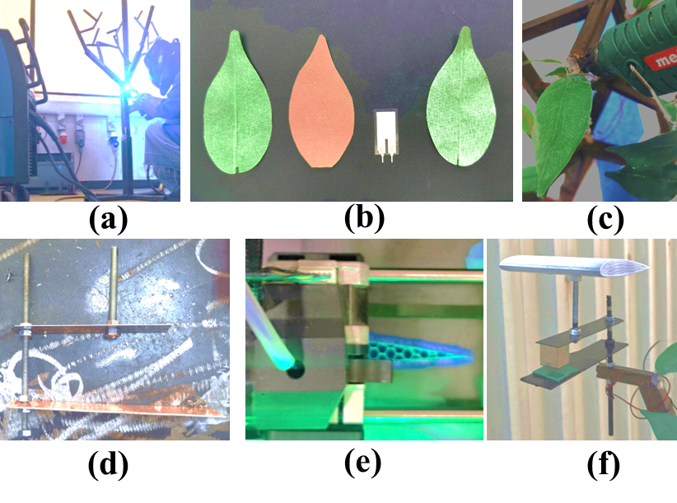
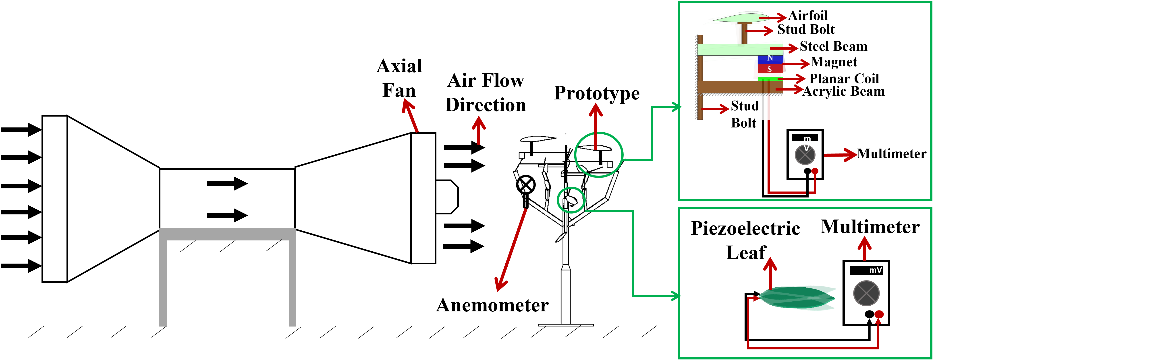
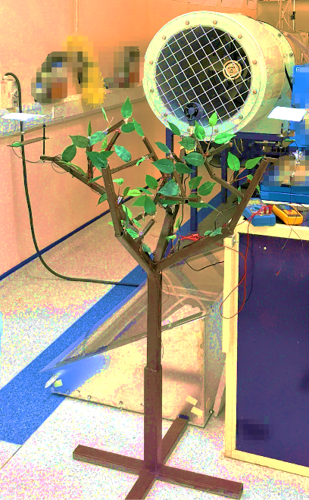
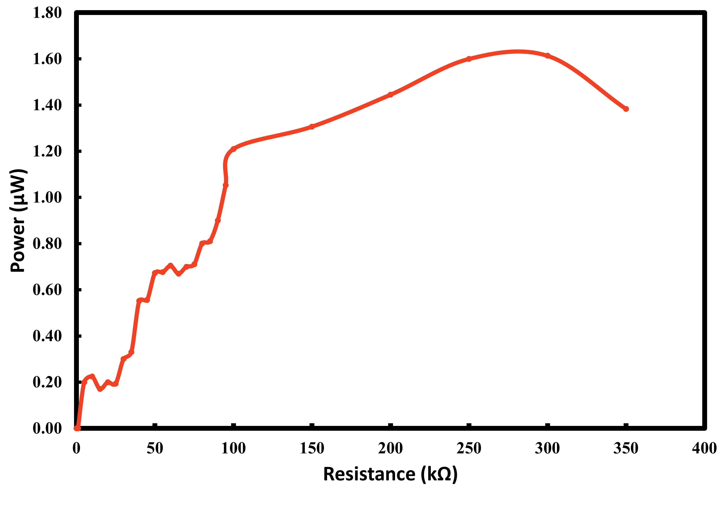
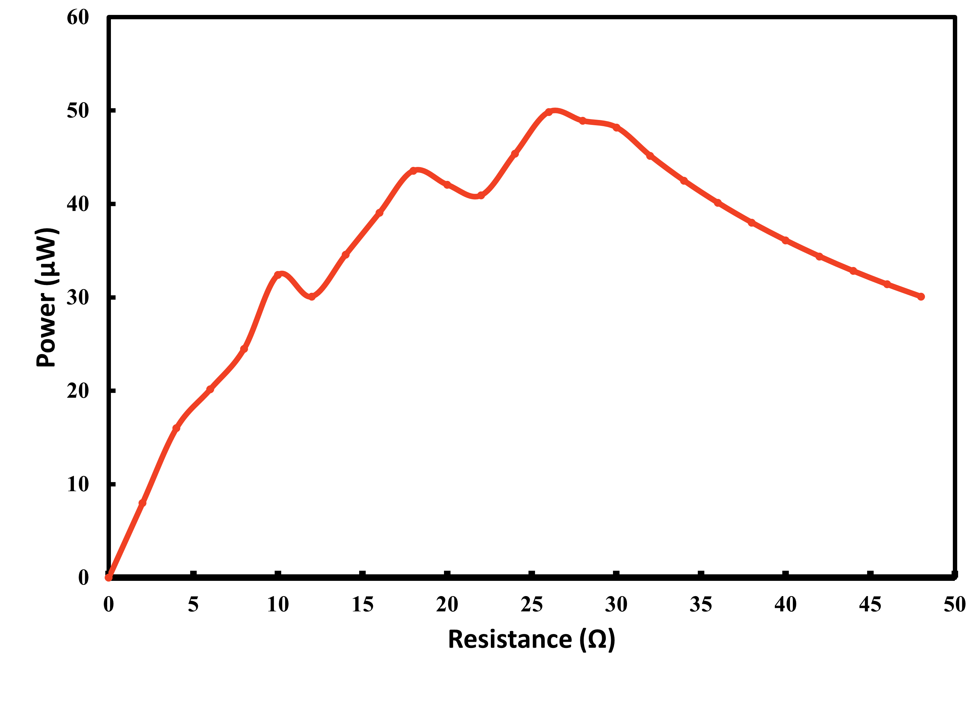
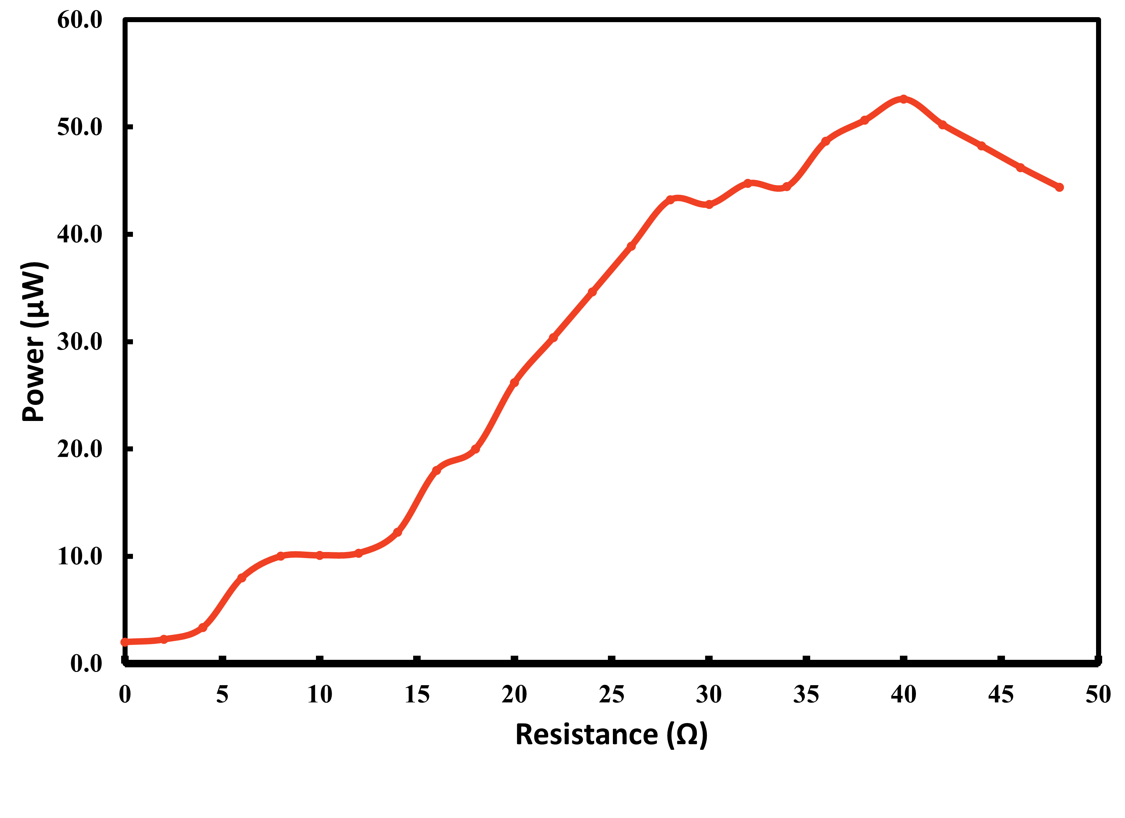
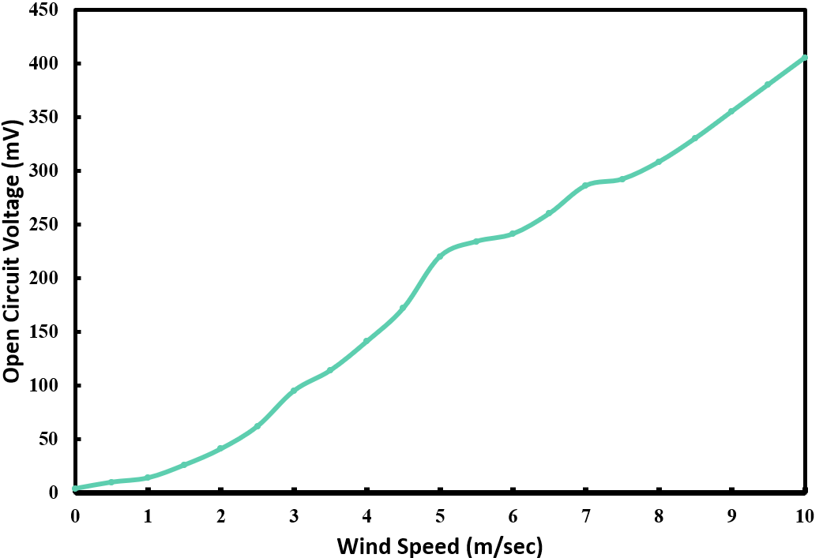
Faculty of Engineering
Design and Development of an Artificial Tree
for Energy Harvesting from Traffic Induced Wind
Student: Alina Tosif – 201801643 | Supervisor: Dr. Iftikhar Ahmad
1. Introduction
4. Methodology
Design & modeling
Wireless Sensor Node
Server Room
2. Problem Statement
Fabrication
Limited Battery Life
Deep Discharge
Regular Maintenance
3. Objectives
To design and develop an artificial tree for energy harvesting.
To test the prototype to evaluate its performance in lab
To test the prototype to evaluate its performance in real time.
5. Experimentation
Experimental Setup
Results
6. Conclusions
A novel hybrid wind energy harvester incorporating both piezoelectric and electromagnetic transduction mechanisms to build a self-powered SHM system was developed.
Due to wind energy, the device is capable of harvesting 1.60 µW from a piezoelectric leaf, 53 µW from a short beam EM-EH and 50 µW from a long beam EM-EH at the constant maximum wind speed of 10 m/sec and at optimum load

Slide 2

Faculty of Engineering
Design and Development of an Artificial Tree
for Energy Harvesting from Traffic Induced Wind
Student: Alina Tosif – 201801643 | Supervisor: Dr. Iftikhar Ahmad
1. Introduction
4. Methodology
Design & modeling
Wireless Sensor Node
Server Room
2. Problem Statement
Fabrication
Limited Battery Life
Deep Discharge
Regular Maintenance
3. Objectives
To design and develop an artificial tree for energy harvesting.
To test the prototype to evaluate its performance in lab
To test the prototype to evaluate its performance in real time.
5. Experimentation
Experimental Setup
Results
6. Conclusions
A novel hybrid wind energy harvester incorporating both piezoelectric and electromagnetic transduction mechanisms to build a self-powered SHM system was developed.
Due to wind energy, the device is capable of harvesting 1.60 µW from a piezoelectric leaf, 53 µW from a short beam EM-EH and 50 µW from a long beam EM-EH at the constant maximum wind speed of 10 m/sec and at optimum load

